Slide 1
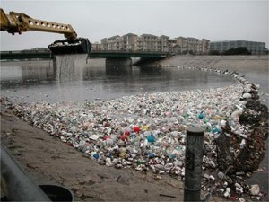
Schools & colleges for
“Plastic Garbage Free Pune

Slide 2
Turn EVS into Adventure Various Activities
Research –Adopt a stream : Stream profiling
Website updating on condition of streams
Adopt a ward – College will adopt a ward
Green Bridge – decentralize Bio-STP on Nalas
Plastic Garbage Free Pune
Engineering for plastic Garbage freedom
Field visits
Dedication to River is Destruction of Corruption: A next step after Anna’s Rally

Slide 3
Plastic Garbage Free Pune
PUNE
Homes
College
Recycling
Shops

Slide 4
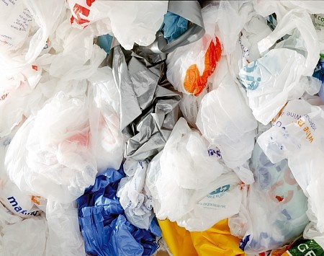
Clean Plastics at home – make it a tight bundle and bring to your EVS class
Clean Garbage Management will collect it @ 15 to 20 Rs a Kilo

Slide 5
Lets make it a fun Activity
Each class will have four groups
Names of the group after any thing in the Nature
Points Charts displayed on the walls where groups will sit during EVS class
Each group will have a leader selected by the students
Points will be maintained on the charts with guidance from the EVS teachers

Slide 6
Group Point Chart
Group Name:
Std & Div:
Date | Jun | Jul | Aug | Sep | Oct | Nov | Dec | Jan | Feb
Weight KCP (convert is as per the chart) /10
Cleanliness/10
Tidiness / 10
Group Creativeness/ 10
Group Discipline/10
Group Initiative/10
Total Points- 60

Slide 7
EVS practical Marks will be as followed
KCP = Kilogram Clean Plastic
42 KCP = 6/10
49 KCP = 7/10
56 KCP = 8/10
63 KCP = 9/10
70 KCP = 10/10.
07 KCP = 1/10
14 KCP = 2/10
22 KCP = 3/10
28 KCP = 4/10
35 KCP = 5/10
Above 70 KCP a month will earn 1 Award Point
1 Award Point = group felicitation with a trophy

Slide 8
Group Points Parameter
Each parameter has 10 point, total points out of 60, which will be calculated out of 10 or as per the decision of the EVS teacher. (40 Marks are designated for projects in schools & colleges)
Award point is given only from the weight because the weight can exceed the given parameter

Slide 9
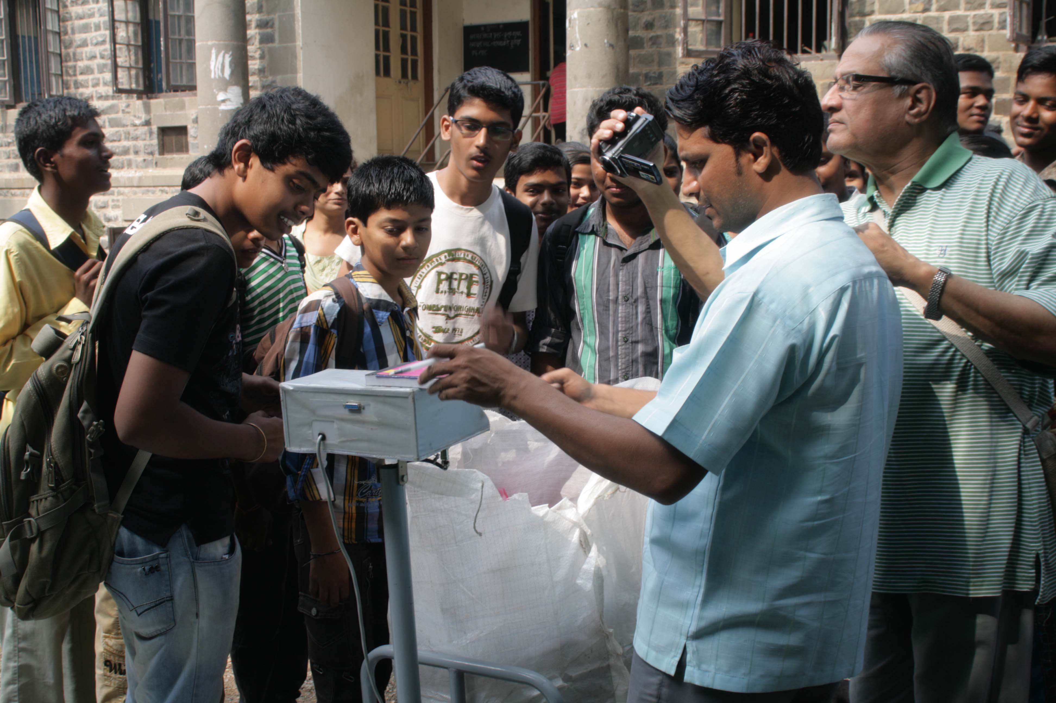
Clean Garbage Management Pvt. Ltd. Will come to collect it

Slide 10
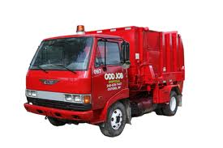
Pick Up
All the collected material will be picked up on the same day of collection

